Slide 1
29 – Clean Code – State Machine Compiler (SMC)
Based on the CleanCoders videos by Uncle Bob Martin
Rupert Waldron

Slide 2
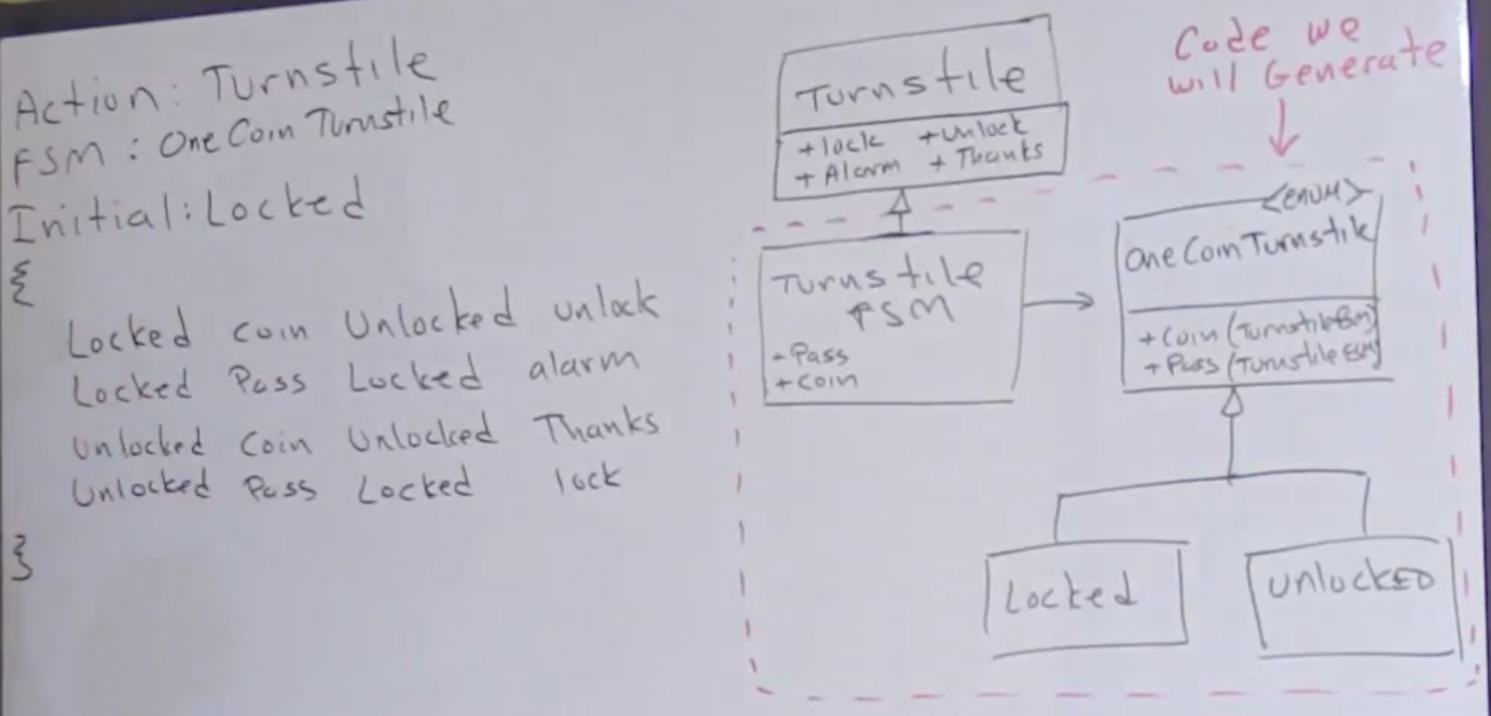
State Machine Compiler (SMC) - Parser
Here we aim to generate our state machine for the turnstile from our state table

Slide 3
State Machine Compiler (SMC) - Parser
Now we have the specification, we can create a formal spec using Backus-Naur Form – BNF.

Slide 4
Backus–Naur form (BNF)
Backus-Naur form is a metasyntax often used to describe the syntax of languages
//OneCoin
Actions: Turnstile
FSM: OneCoinTurnstile
Initial: Locked
{
Locked {
Coin Unlocked {alarmOff unlock}
Pass Locked alarmOn
}
Unlocked {
Coin Unlocked thankyou
Unlocked Pass Locked lock
}
}
FSM::=<Header>*<Logic>
<Header> ::= <Name> “:” <Name>
<Logic> ::= “{“ <Transition>* “}”
<Transition> ::= <State> “{“ <State-Spec> “}”
<State> ::= <Name>
<State-Spec> ::= <Event> ” ” <State> ” ” <Action>
<Event> ::= <Name>
<Action> ::= <Name> | “{“ <Name> “ ” <Action> “}”
<Name> ::= \w+
Headers

Slide 5
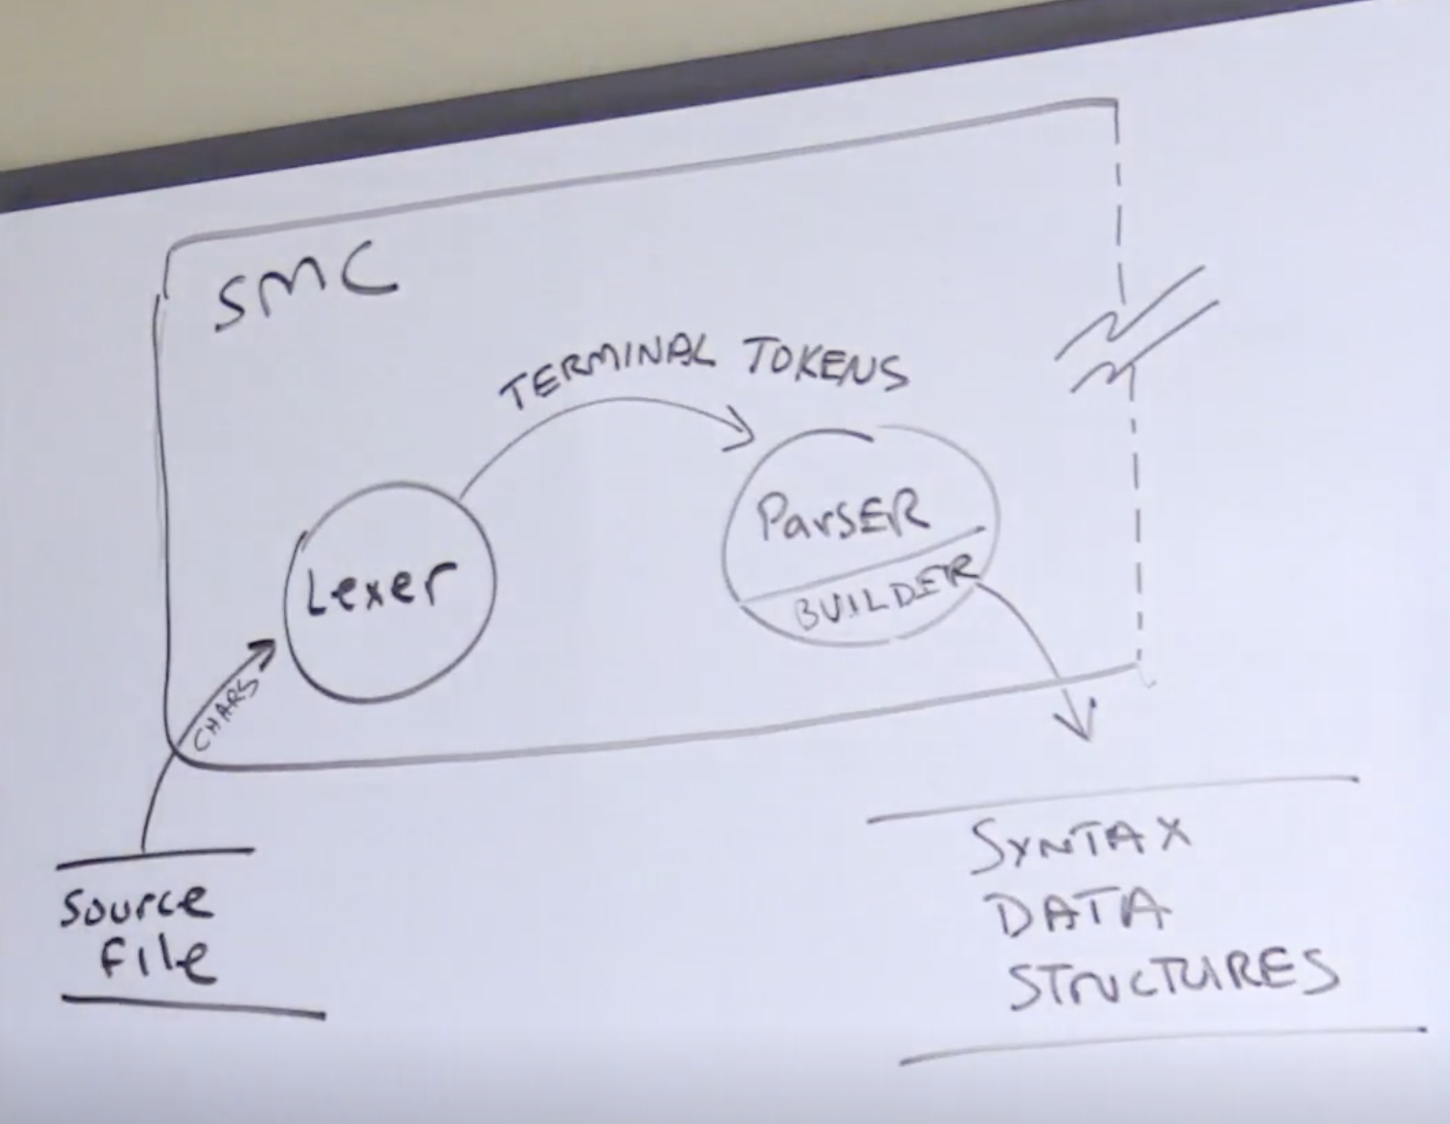
Lexical Analysis – Parsing our structure
Any system that can be represented in BNF can be parsed with a finite state machine
you can implement a parser by implementing the right finite state machine
Create the Lexer and then parse the structure string to create the data structures
The Data structures don’t know anything about the Lexer or the Parser

Slide 6
State Machine Compiler (SMC)
Now we have the specification, we can create a formal spec using Backus-Naur Form – BNF.

Slide 7
Backus–Naur form (BNF)
Backus-Naur form is a metasyntax often used to describe the syntax of languages
//OneCoin
Actions: Turnstile
FSM: OneCoinTurnstile
Initial: Locked
{
Locked {
Coin Unlocked {alarmOff unlock}
Pass Locked alarmOn
}
Unlocked {
Coin Unlocked thankyou
Unlocked Pass Locked lock
}
}
FSM::=<Header>*<Logic>
<Header> ::= <Name> “:” <Name>
<Logic> ::= “{“ <Transition>* “}”
<Transition> ::= <State> “{“ <State-Spec> “}”
<State> ::= <Name>
<State-Spec> ::= <Event> ” ” <State> ” ” <Action>
<Event> ::= <Name>
<Action> ::= <Name> | “{“ <Name> “ ” <Action> “}”
<Name> ::= \w+
Headers

Slide 8
State Machine Compiler (SMC) – Semantic Analysis

Slide 9
Lexical Analysis – Parsing our structure
Any system that can be represented in BNF can be parsed with a finite state machine
you can implement a parser by implementing the right finite state machine
Create the Lexer and then parse the structure string to create the data structures
The Data structures don’t know anything about the Lexer or the Parser

Slide 10
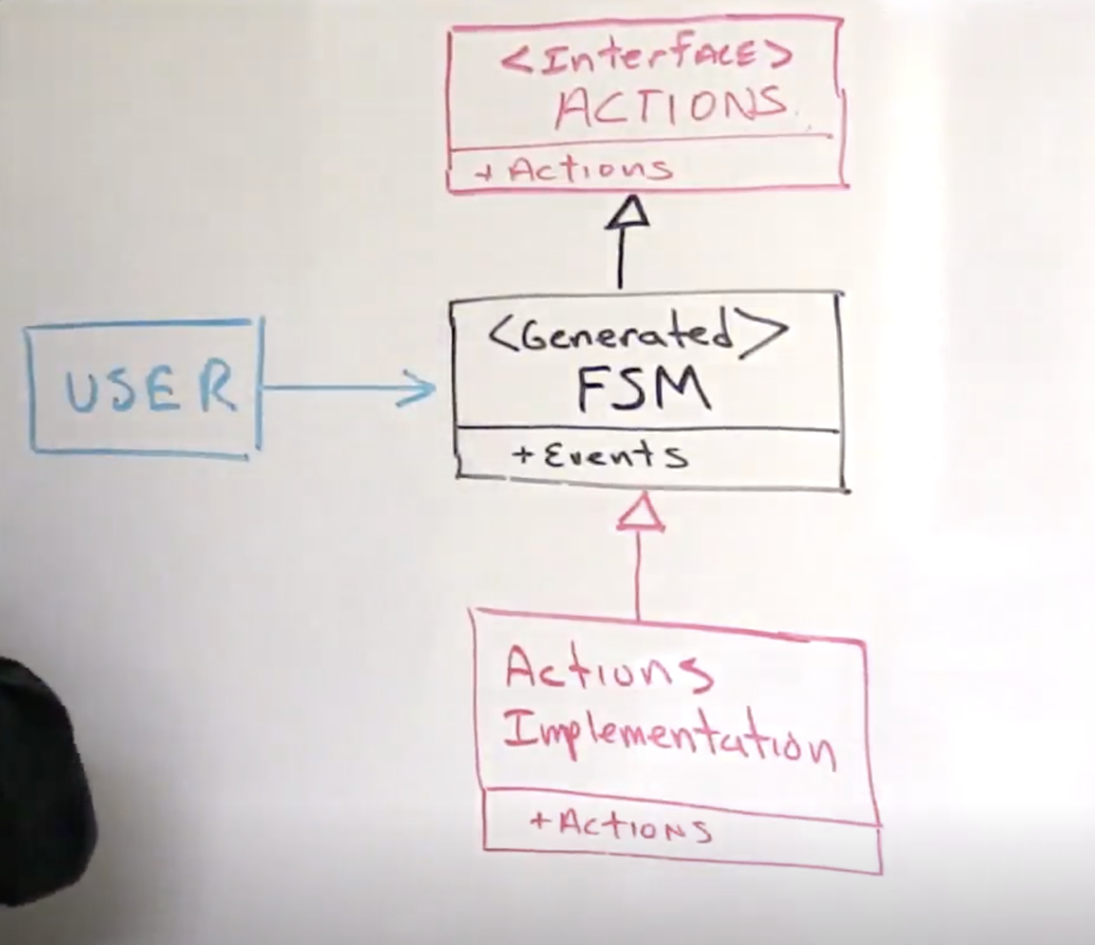
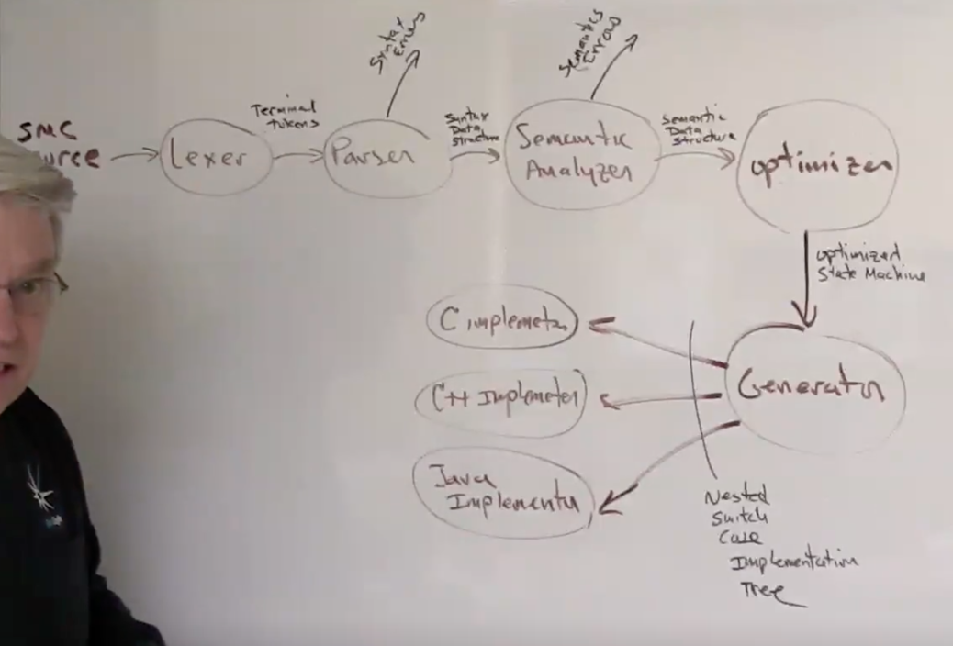
Generate the code
Use the NSCNode interface to generate a Nested Switch Case Node which is independent of the language required. Use the Visitor Pattern

Slide 11
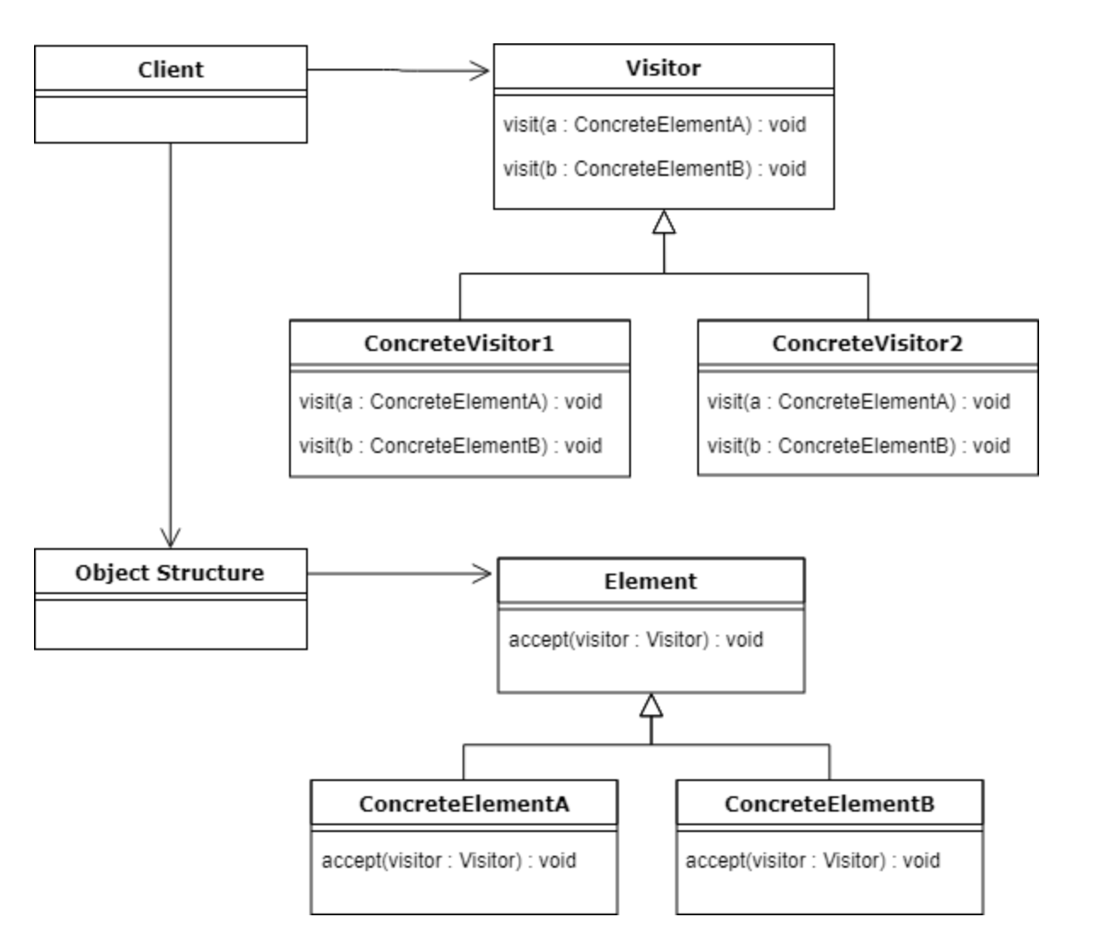
Visitor Pattern
Use the visitor pattern when you want to add behaviour to a class but don’t want that class to contain the behaviour.
Adding the functionality provided to the class would break the Single Responsibility Principle – the objects don’t care about the new functionality which is required by another Actor.
It also violates the Open Close Principle because each time new functionality is required it would have to be added to the class.

Slide 12
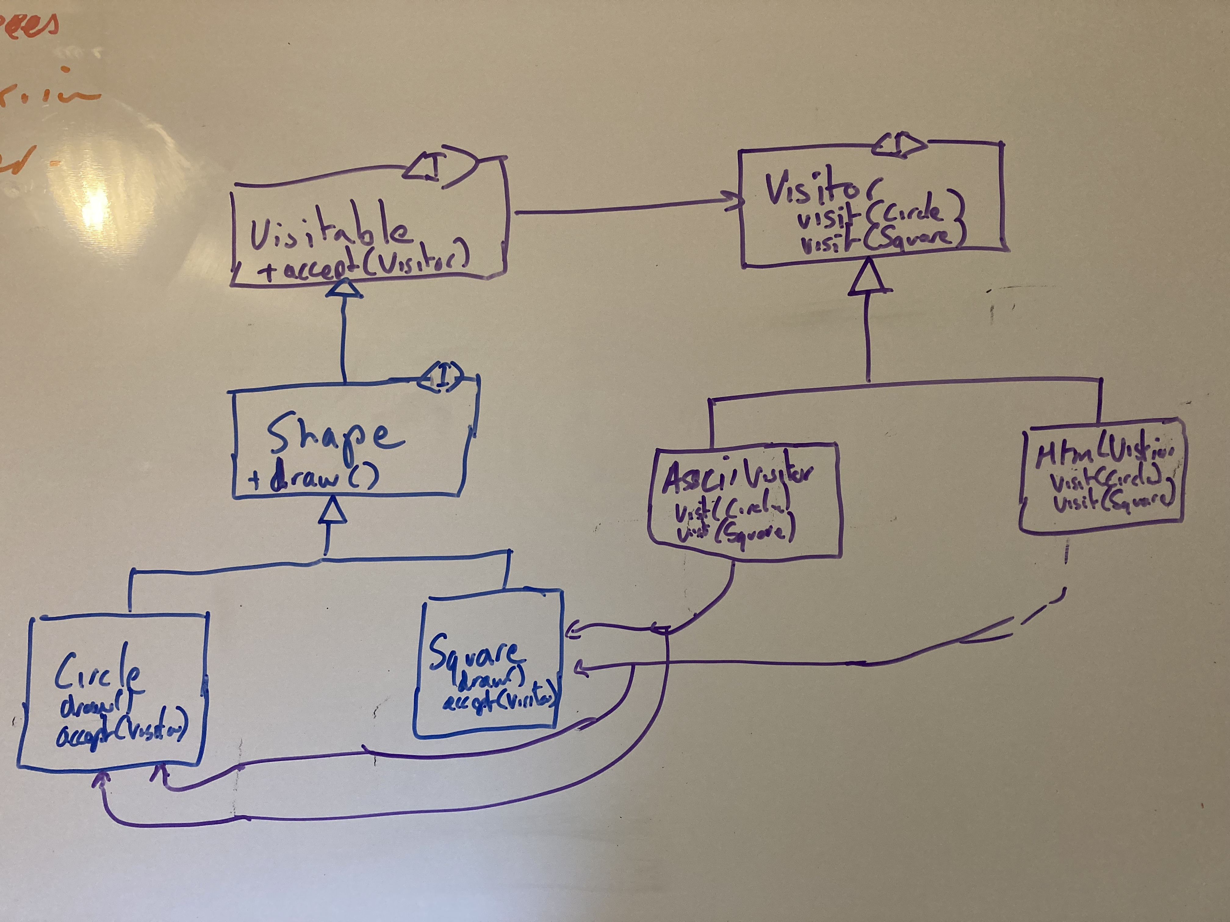
Visitor Pattern
The Shape example – we want to out an output format functionality to the Shape classes – without adding that functionality to the Shape classes.

Slide 13
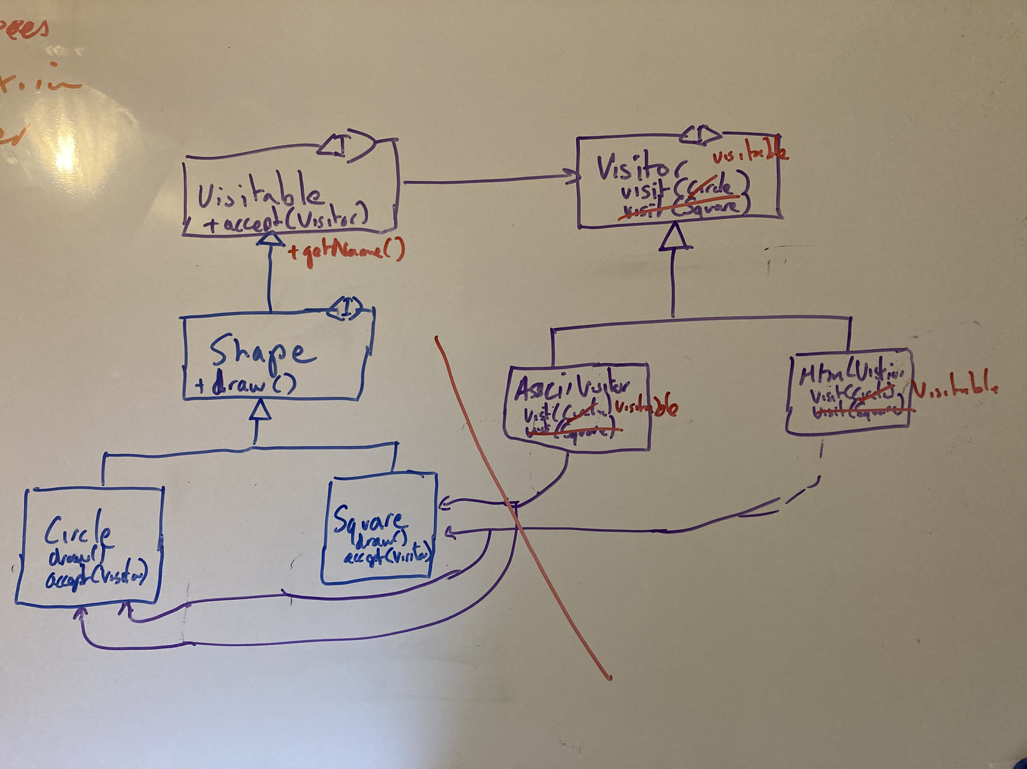


Visitor Pattern - Coupling
The Visitor needs to know about the type of Shape in the original design. Because we are only using some information from the Shape we can use a default method and break the coupling.
Cyclic Dependency
Separate this package

Slide 14
Back to “Generate the code” Using the Visitor Pattern

